Slide 1


CYBER SECURITY
RSA ENCRYPTION ALGORITHM

Slide 2
OBJECTIVES
Introduction
Background
Protocols
Example of use
Pros & Cons
Implementation

Slide 3
INTRODUCTION:
Why RSA?
Problem with Symmetric Encryption

Slide 4

BACKGROUND:
RSA was introduced in 1977 by Leonard Adleman, Adi Shamir, and Ronald Rivest. It uses both a public and a private key: the public key encrypts the message, and the private key decrypts it. This ensures confidentiality, integrity, and authenticity, as only the person with the private key can read the encrypted data. RSA is widely used in protocols like Secure Shell (SSH) and SSL/TLS for secure communication.

Slide 5
PROTOCOLS
TLS
SSH

Slide 6

EXAMPLE OF USE:
Banks rely on RSA encryption

Slide 7


PROS & CONS:
Key Distribution
Key Size
Asymmetric Encryption
Message Size Limitation
Digital Signatures
Key Management

Slide 8






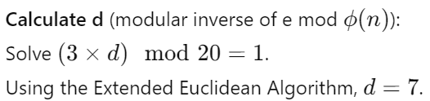






Key Generation:

Slide 9
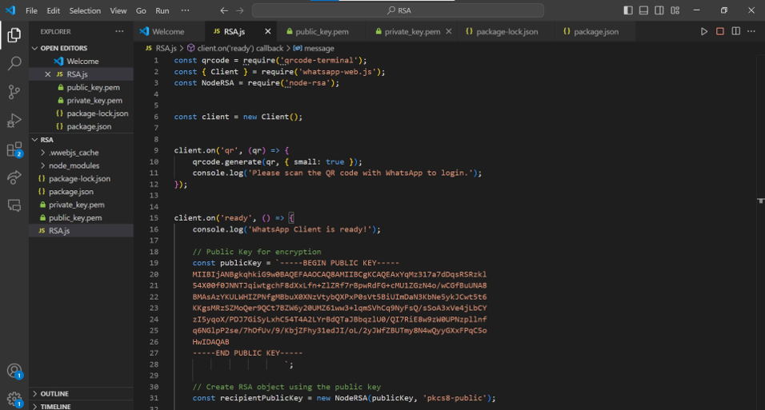
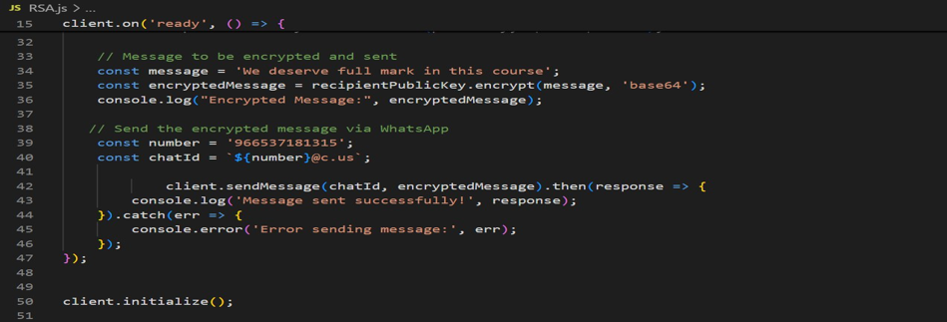
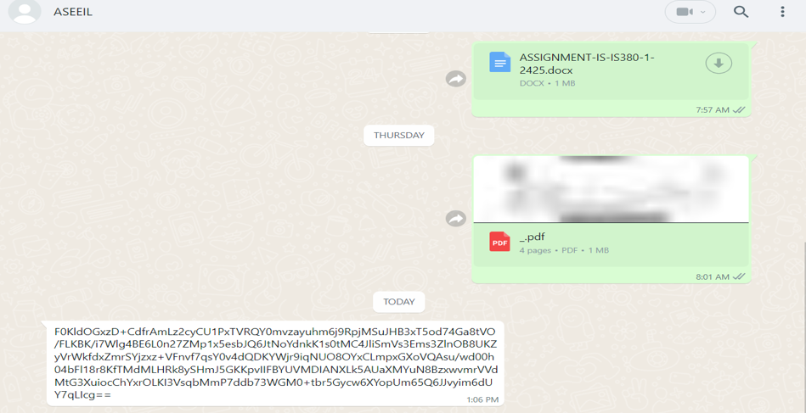
Encrypt the message from the sender
The cyphertext

Slide 10
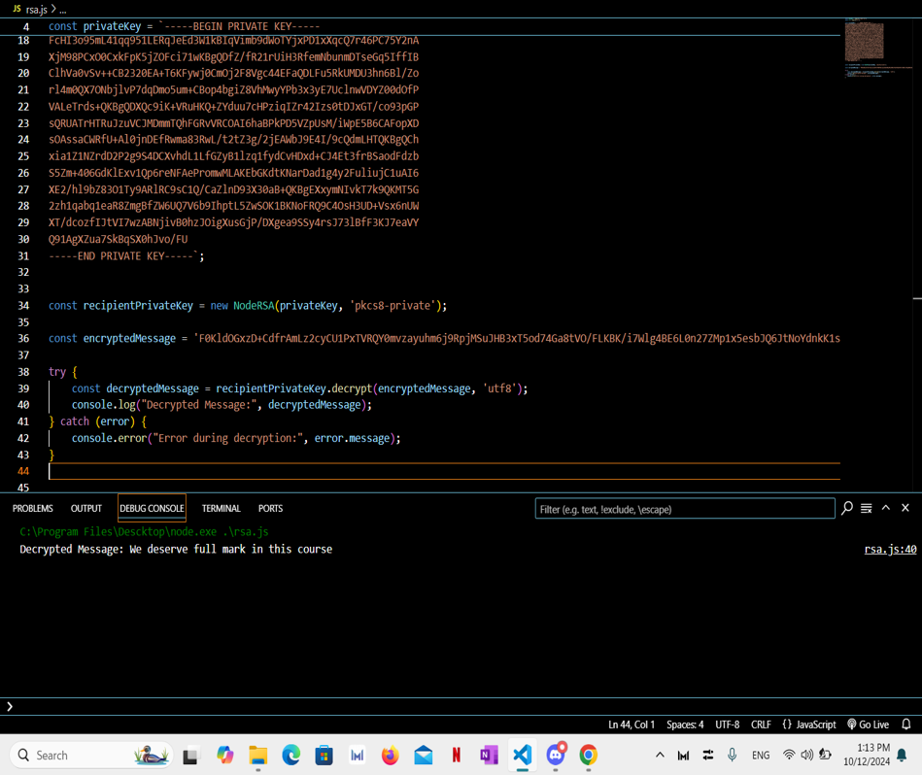
Decrypt the cyphertext from the receiver

Slide 11
THANK YOU
ANY QUESTION?

